Slide 1

Introduction to Electromagnetic Compatibility
F. Rachidi
École Polytechnique Fédérale de Lausanne
Electromagnetic Compatibility Laboratory
Farhad.Rachidi@epfl.ch
http://emc.epfl.ch

Slide 2
Outline
EMC Overview
Problem definition
Various EMI environments
Examples of EMI effects on systems
EMC Specifications and Standards
History of EMC
Decibels and Common EMC Units

Slide 3
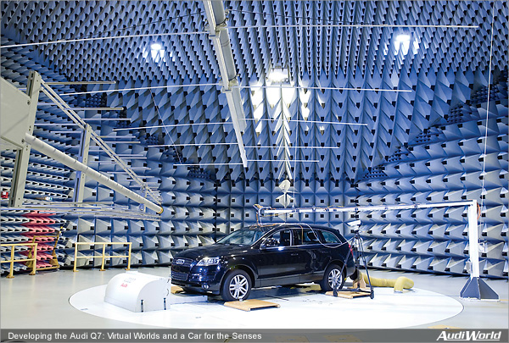
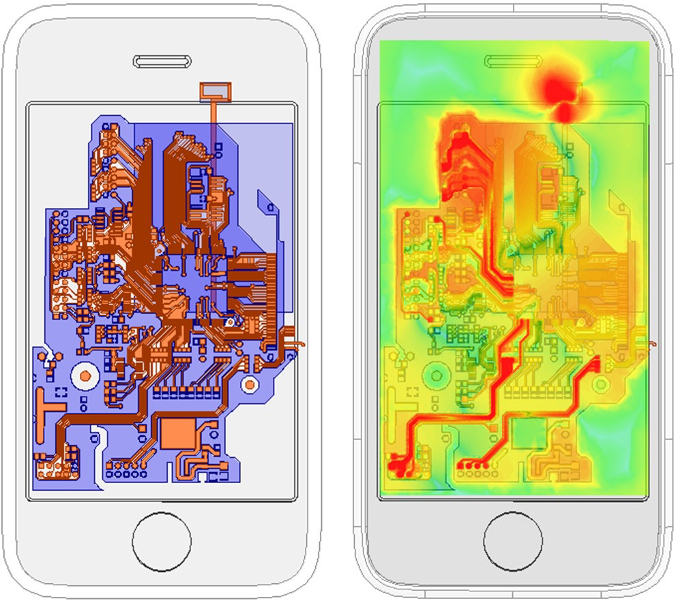
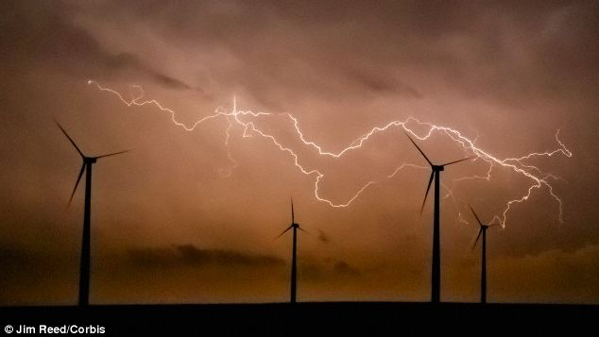
What is EMC?
EMC deals with interference and the prevention of it through the design of electronic systems.
Notes:
It’s a very broad discipline ranging from nano and microelectronics to communications and power systems.
Sources of interference can be natural or man-made

Slide 4
Useful Definitions
Electromagnetic Disturbance (EMD)
Any electromagnetic phenomenon which may degrade the performance of a device, equipment or system.
Electromagnetic Interference (EMI)
Degradation of the performance of a device, transmission channel or system caused by an electromagnetic disturbance.
Electromagnetic Susceptibility (to a disturbance)
The inability of a device, equipment or system to perform without degradation in the presence of an electromagnetic disturbance.
NOTE - Susceptibility is a lack of immunity.
Electromagnetic Immunity (to a disturbance)
The ability of a device, equipment or system to perform without degradation in the presence of an electromagnetic disturbance.

Slide 5
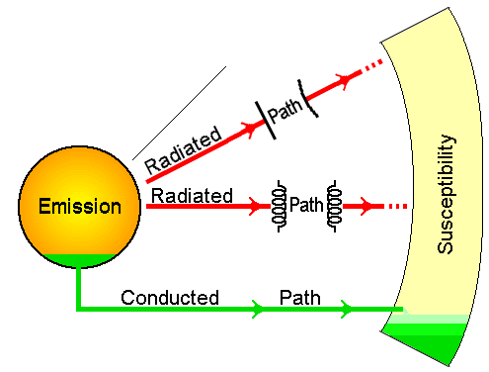
Fundamental Elements of EMC
Evaluation of the propagation of the EM environment from the source to the “victim”.
Study of the effects of the EM environment on equipment (damage, upset, loss of function, etc.
Study and characterization of the sources producing the interfering EM environment.
By E-field (or capacitive) interaction mechanisms.
By H-field (or inductive) interaction mechanisms.
By conducted (hard-wired) interactions.

Slide 6
EMC: Definition
A system is electromagnetically compatible with its environment if it satisfies three criteria:
It does not cause interference with other systems
It is not susceptible to emission from other systems
It does not cause interference with itself

Slide 7
Aspects of EMC
Coupling Path
Source
Victim
(receptor)
Interference occurs if the received energy causes the receptor to behave in an undesired manner.
Three ways to prevent interferences:
Suppress the emission at its source
Make the coupling path as inefficient as possible
Make the receptor less susceptible to the emission

Slide 8
Example: Reduction of Emission at its Source
Fast (short) rise/falltimes of digital pulses are the primary contributors to the high frequency spectral content of these signals.
In general, the higher the frequency of the signal to be passed through the coupling path, the more efficient the coupling path.
So we should increase (slow) the rise/falltimes of digital signals as much as possible.
However, these can be increased only to a point at which the digital circuitry malfunction

Slide 9
Example: Reduction of Emission at its Source (cont’d)
Digital signals
GTL+ : t_{r} = 300 ps
ECL: t_{r} = 100 ps
x(t)
A
A/2
τ
τ_{r}
τ_{r}
t
T

Slide 10
Example: Reduction of Emission at its Source (cont’d)
Spectrum Envelope
2Ατ/T
-20 dB/decade
-40 dB/decade
f
1/(πτ)
1/(πτ_{r})

Slide 11
Overview of Radiated EM Interference (EMI)
Radiated EMI is most often found in the frequency range from 30 MHz to 10 GHz (according to the Standards).
Emission Sources Clocks, clock lines, data lines; switching power supplies
Susceptibility Clock lines & data lines poorly laid out, improperly terminated
Solutions Balanced transmission lines, proper terminations, groundplanes, shielding, limited rise & fall time drivers
Solutions Shielding, layout, filtering, groundplanes, differential line receivers

Slide 12
Overview of Conducted EM Interference (EMI)
Conducted EMI is most often found in the frequency range of several kHz to 30 MHz (according to the Standards).
Emission Sources Power supplies (switching), power rails, motors, relays
Susceptibility A.C. power cord poorly filtered, power rails poorly decoupled
Solutions Good bypassing & decoupling practices, layout, groundplanes, shielding
Solutions Good bypassing & de-coupling practices, layout, groundplanes, shielding, power line filtering

Slide 13

Categories of EMC Problems

Slide 14
There Are Many Different Types of Sources in EMC
Natural Sources
Lightning
Electrostatic discharge (ESD)
Triboelectric charging effects
Solar & cosmic noise, and
Geomagnetic field effects

Slide 15
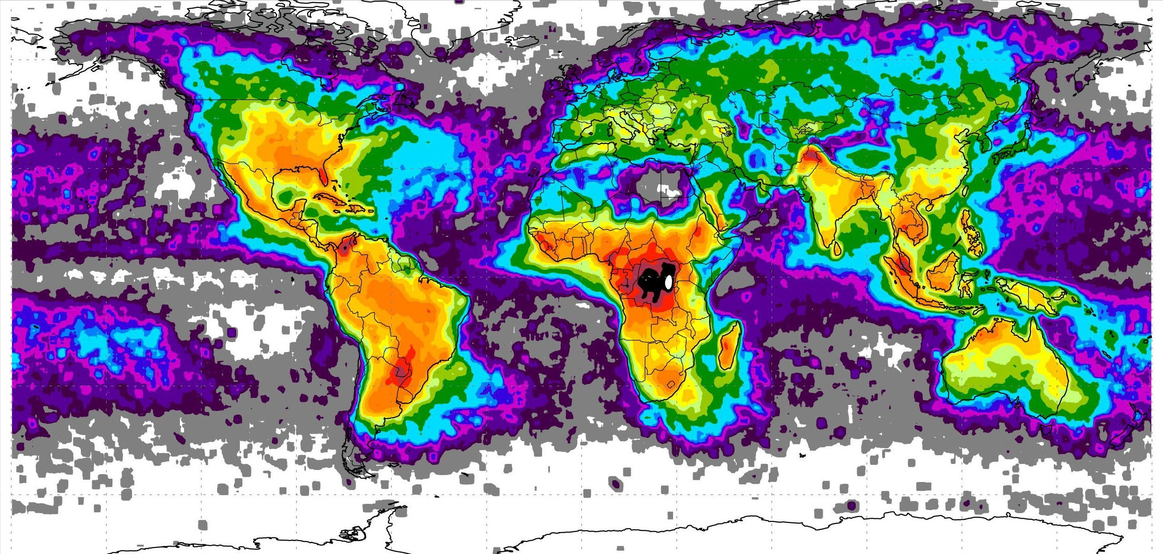
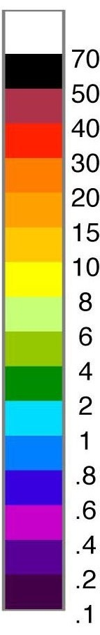
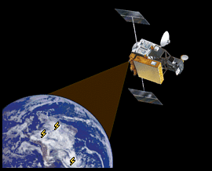
Lightning Discharge
Lightning Incidence
0.2 | 0.4 | 0.6 | 0.8 | 1 | 2 | 4 | 6 | 8 | 10 | 15 | 20 | 30 | 40 | 50 | 70
Source: NASA, observation period: 04/1995 – 02/2003
Notes:
A global map of total lightning flash density (per square kilometer per year) based on data from two satellite detectors, OTD (5 years) and LIS (3 years)

Slide 16
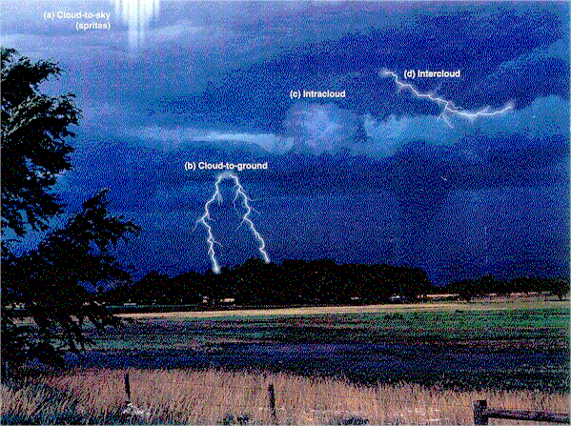
Lightning Discharge
Major Types of Lightning

Slide 17
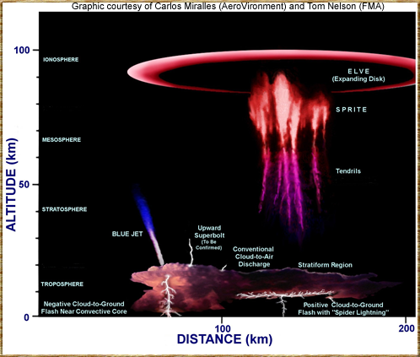
Lightning Discharge
Lightning effects in the middle and upper atmosphere

Slide 18
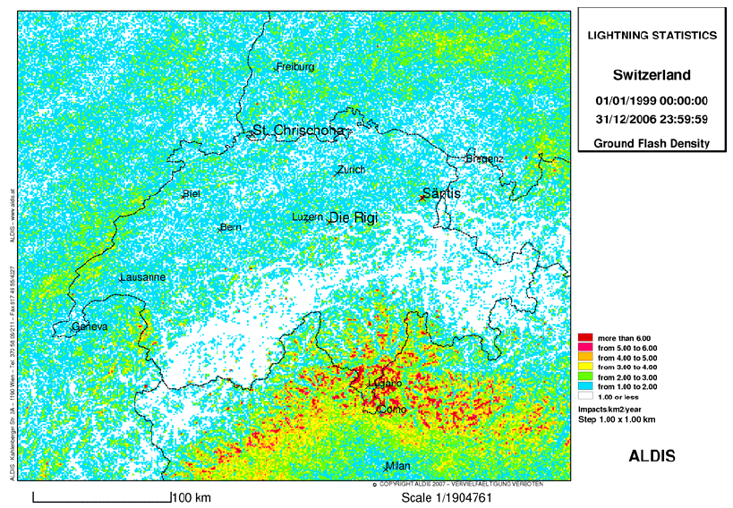
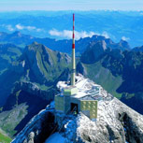
Lightning Activity in Switzerland:
Flash Density: Number of Flashes per km² per year
200’000 discharges per year

Slide 19
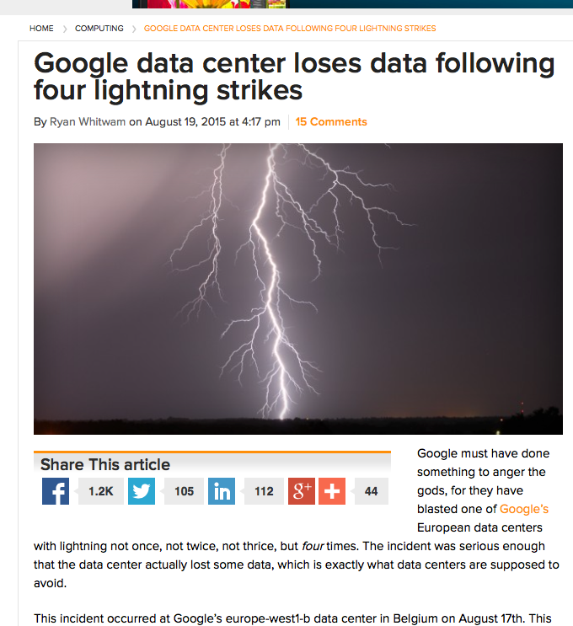
Notes:
Example of a recent event illustrating EMC. This happened a couple of weeks ago and following a lightning strikes, a number of disks were damaged in the Google data center in Belgium.
Lightning is one of the most important sources of electromagnetic disturbances, epecially considering the fact that every second more than 50 lightning flashes strike the earth on average!

Slide 20
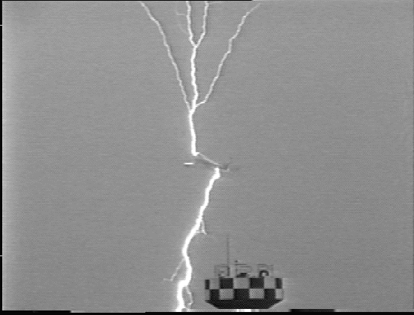
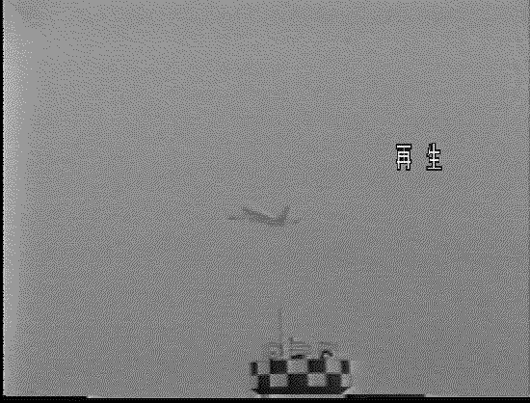
Lightning to Aircraft
Kamatzu airforce base, Japan

Slide 21
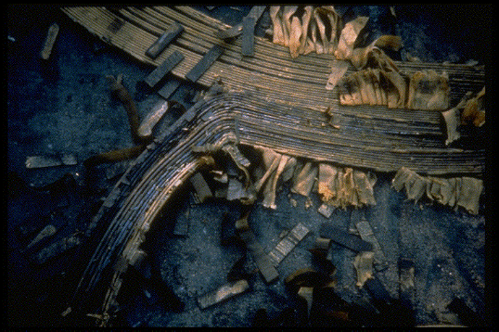
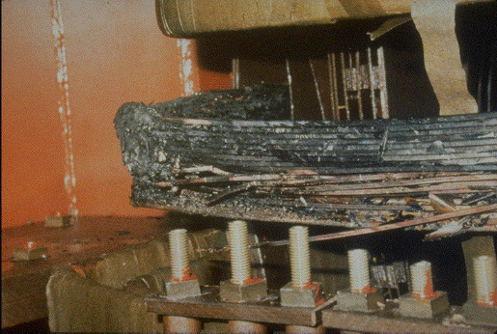
Geomagnetic storms: March 13, 1989
Entire Hydro Quebec power system collapsed due to G5 geomagnetic storm
6 million customers lost power
Entire system collapsed in 90 seconds
Restoration took 9 hours
Notes:
Coronal mass ejection (CME) from the Sun: If this massive bubble of plasma and radiation is aimed right at Earth, it can pose a serious threat to satellite operations and even to power grids on the ground. On March 10, 1989, a coronal mass ejection (CME) about the size of 36 Earths erupted from the sun's roiling surface and ripped through space at 1.6 million kilometers per hour. Two days later, the torrid gas cloud crashed against Earth's magnetosphere—the magnetic field generated by the planet's spinning molten iron core that helps deflect the solar wind and more potent solar jetsam. This blast from the sun severely disrupted the magnetosphere and set off a geomagnetic superstorm.
These electrical surges infiltrated power grids all over North America and northern Europe, and even destroyed a transformer at a nuclear power plant in New Jersey.
Such storms occur every 60 years or so.

Slide 22
EMC Sources (cont’d)
Man-made Sources
Electric power system noise
Computer clock circuitry
Switching power supplies
Electric motors
Radio/radar transmissions
Automotive and railroad noise, and
Nuclear electromagnetic pulse (NEMP)

Slide 23
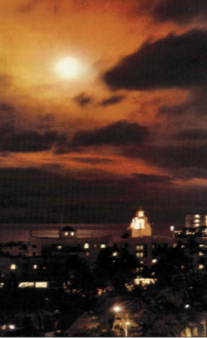
High Altitude EMP: Starfish Prime
July 9, 1962
The first HEMP
400 km above Pacific
EMP affected electric power in Hawaii
Notes:
The first human-caused EMP occurred in 1962 when the 1.4 megaton Starfish Prime thermonuclear weapon detonated 400 km above the Pacific Ocean.
One hundred times bigger than what dropped on Hiroshima, Starfish Prime resulted in an EMP which caused electrical damage nearly 900 miles away in Hawaii. It knocked out about 300 streetlights, set off numerous burglar alarms, and damaged a telephone company microwave link that shut down telephone calls from Kauai to the other Hawaiian islands.
And that was from 900 miles away.
and in 1962, we were not using sensitive electronic devices as we are today.

Slide 24
With Such Diverse Sources, Many Different Types of Signal are Found
Narrow-band, or continuous wave (CW) spectra
Transients
Large-amplitude signals (lightning & NEMP), and
Weak signals (radio signals, micro-circuitry signals)

Slide 25
Examples of EMI Sources

Slide 26
Radio and TV Services Also Can Produce EMI

Slide 27
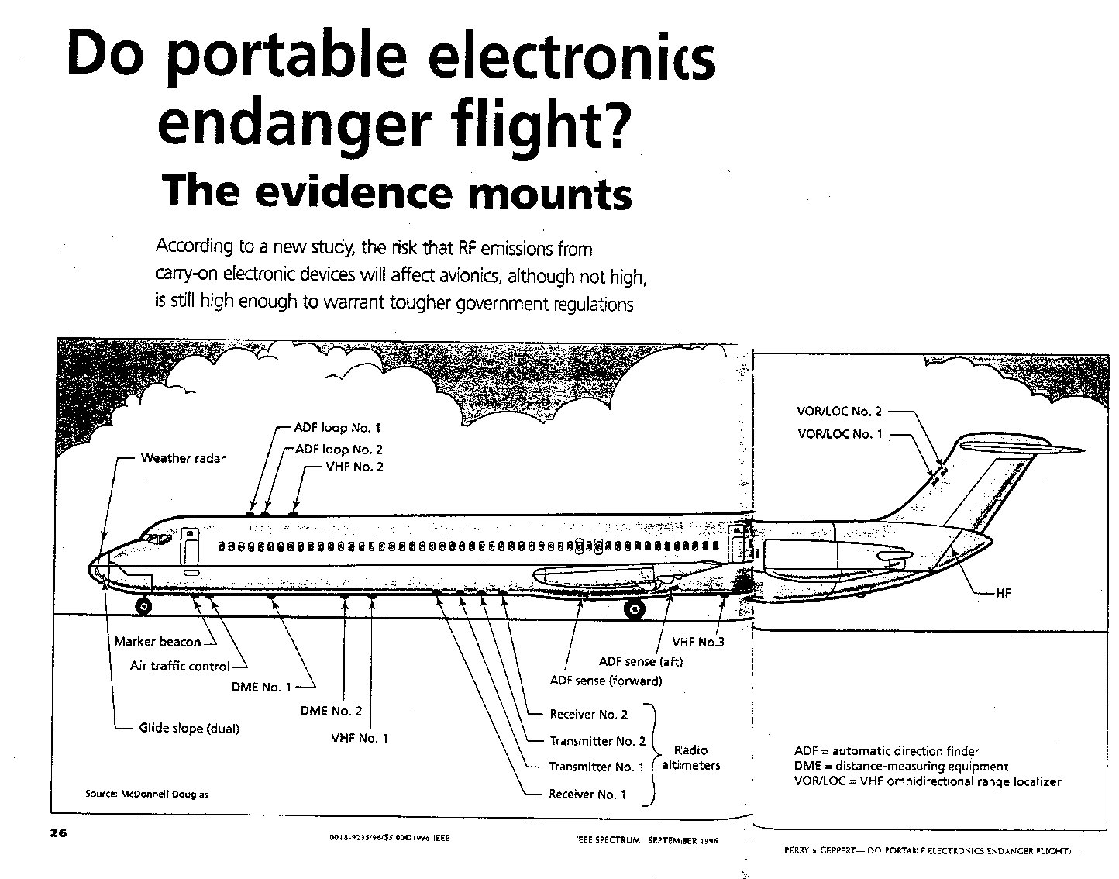
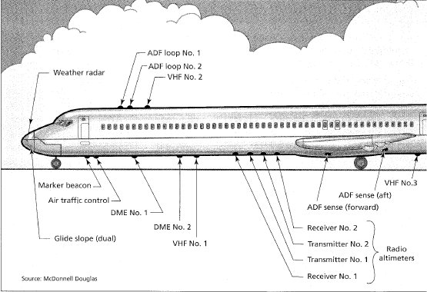
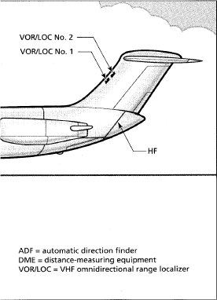
Example of a Complex System

Slide 28



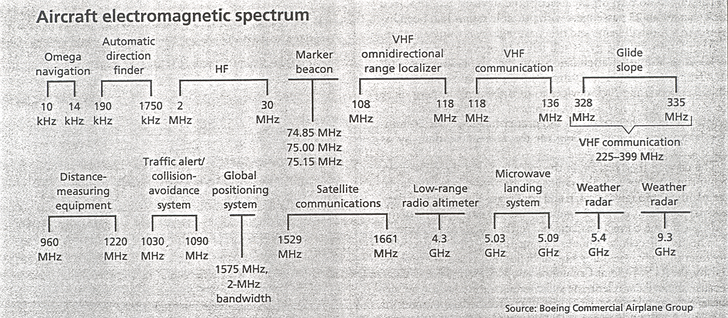
Example of a Complex System

Slide 29
Transient Signals and Spectra Are Related
The relationship between the frequency spectral content F(ω) and the transient waveform f(t) is given by the Fourier Transform relationships:

Slide 30
Relationships Between Transient and Spectral Responses

Slide 31
Transient and Spectral Relationships (cont’d)

Slide 32
Improper EMC Design May Cause Problems
Unwanted or unplanned EM stresses have caused equipment upset and damage to components
Let’s examine a few cases ……

Slide 33
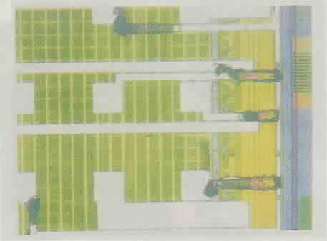
Electrical Damage to Components
Example of a 7.5 kV voltage surge on a silicon-based microprocessor
Typical of what might be expected from a lightning-induced surge or electrostatic discharge (ESD)
Burn-out damage of the aluminum interconnects on the chip

Slide 34
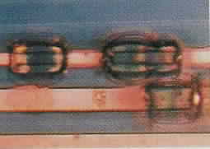
Electrical Damage to Components (cont’d)
Examples of damage to copper vias on a printed circuit board, subjected to large currents
The basic damage mechanism is the vaporization of the circuit material by heat (I²R loss) in the conductor

Slide 35
Effects of EMD on Systems
There can be many different types of effects of an electromagnetic disturbance (EMD) on an electrical system, which is comprised of many individual components
Temporary EM interference (EMI)
noise in analog systems or recoverable upset in digital systems
Permanent loss of function of the system (permanent upset)
requiring manual intervention (computer reboot)
Equipment damage due to component failure
Increasing power level of the EMD

Slide 36
Data on Computer System Upset¹
Experimental study of EM field coupling to PCs
Performed in an anechoic chamber
PC was illuminated by a horn antenna from a distance of 1m
E-field varied up to 100 V/m.
Three different PCs were tested
Varying frequencies, field strengths and modulation of the carrier.
1. LoVetri, J, A.T.M. Wilbers and A.P.M. Zwamborn, “Microwave Interaction with a Personal Computer: Experiment and Modeling”, Proceedings of the 1999 Zurich EMC Symposium.

Slide 37
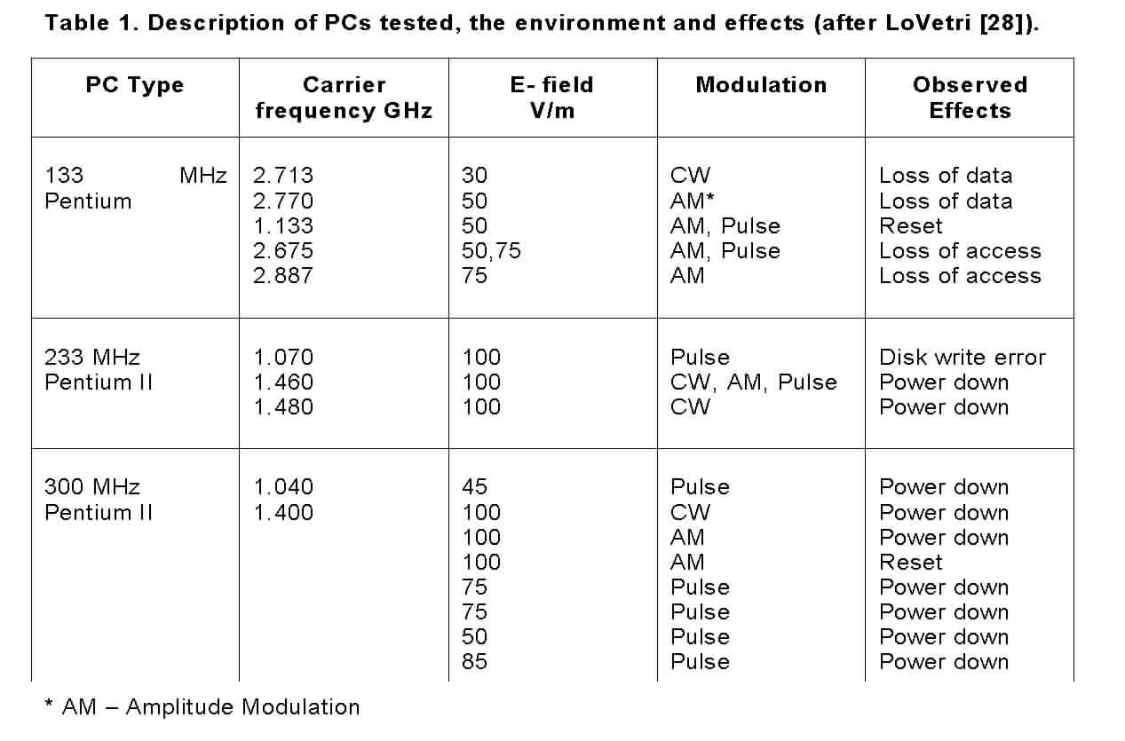
Data on Computer System Upset (cont’d)

Slide 38
Possibility of Permanent Damage²
High Power EM (HPEM) susceptibility testing was conducted on automobiles, PC's and unshielded military equipment
Used radar pulses at 1-3 GHz with a few microsecond pulse length and pulse repetition frequencies around 1 kHz
Results included
Interference/upset (requiring a reboot or restart of a car) occurred for field strengths of a few 100 V/m
Permanent damage required 20-30 dB higher levels.
2. M. Bäckström, "HPM Testing of a Car: A Representative Example of the Susceptibility of Civil Systems," Workshop W4, Proceedings of the 13th International Zurich Symposium and Technical Exhibition on EMC, February 1999, pp. 189-190.

Slide 39
Possibility of Permanent Damage (cont’d)
Conclusions:
Upset could be caused in unprotected electronic systems from a maximum distance of around 500 meters for a high-power microwave (HPM) source
Possibly located in a vehicle like a van or truck
For a source of a smaller size, such that it can be located in a suitcase, the estimated distance decreases to 50 meters.
The maximum distance for causing permanent physical damage was estimated to be around 15 meters for the HPM van,
while the suitcase source had to be placed very close to, or even in direct contact with the system.

Slide 40
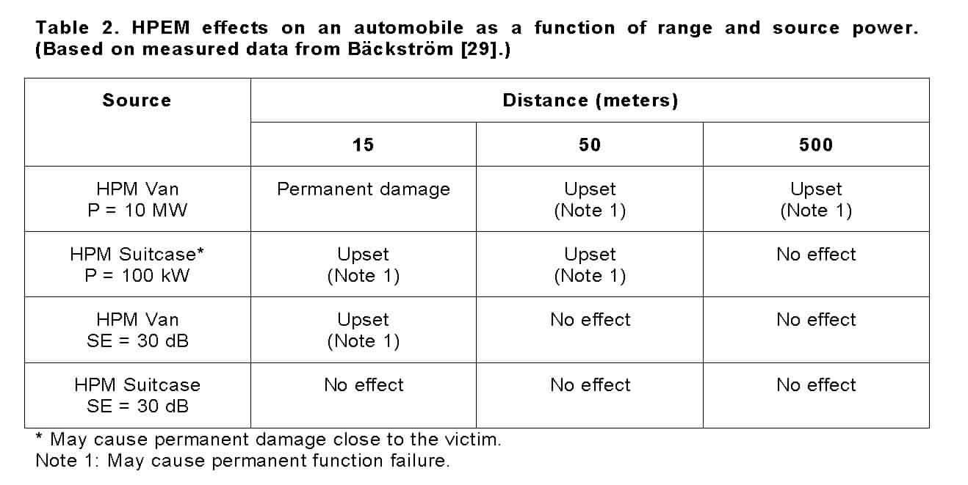
Summary of HPEM Effects from Bäckström

Slide 41
Predicting Upset and/or Damage is Very Complicated
This depends on many factors:
EM source parameters
Distance, orientation, polarization
Waveform characteristics
Carrier frequency, pulse repetition, signal strength
System (victim) electrical configuration
Coupling characteristics (topology), shielding, cable design
System robustness
Failure levels of components, upset levels of electronics
State of the system (for upset issues)
With so many parameters describing upset and/or damage thresholds, statistical methods are often used to describe system behavior to EMD.

Slide 42
Demonstrated EMI Effects Have Led to the Concept of an Electromagnetic Weapon
The basic idea is to deliberately illuminate a system with EM fields, thereby causing failure or damage
High power microwave (HPM) sources and radiators (antennas) are being studied and developed, and
Fast-pulse sources (ultra-wide band) have been developed

Slide 43
Counter-electronics High-Powered Missile Project Test
http://bcove.me/h1kel0mp

Slide 44
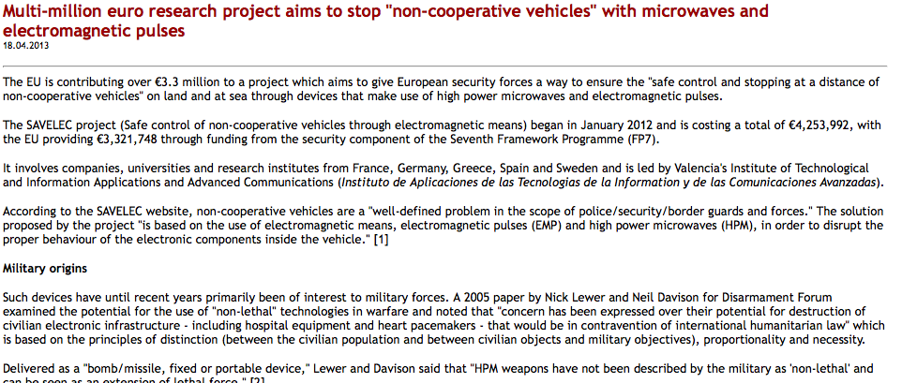
Other Applications of High Power Electromagnetic (HPEM) Sources

Slide 45
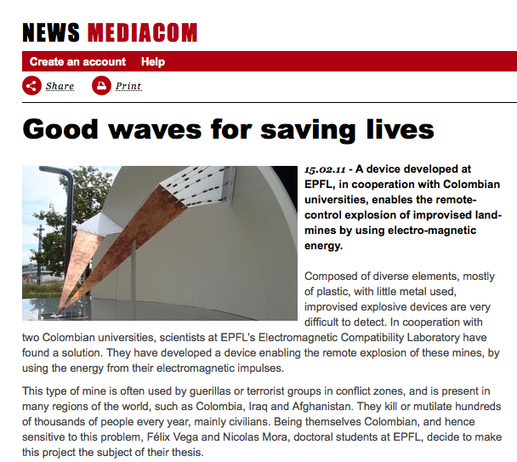
Other Applications of HPEM Sources

Slide 46
Functional Divisions in EMC
There are two major disciplines within the EMC area
One dealing with regulatory and administrative issues
The other with design, modeling and analysis

Slide 47
Functional Divisions in EMC (cont’d)
These two different disciplines are related by testing
Component “bench” testing,
EMC compliance testing, and
System susceptibility testing

Slide 48
EMC Specifications and Standards
Many EMC activities are mandated by governmental standards or requirements:
for promotion of health and safety, and
for compatible operation of electrical equipment
Pertinent activities include the development of
Emission standards for equipment,
Susceptibility standards for equipment,
Test methodology and protocol, and
Design standards.

Slide 49
Common Standards for Commercial Products
Two different classes of digital equipment are defined
Class A - Devices operating in a commercial, industrial or business environment
Class B - Devices operating in a residential environment
Limitations on the EM interference from these devices are specified through
Conducted emissions
Radiated emissions
Class B requirements are more stringent that Class A

Slide 50
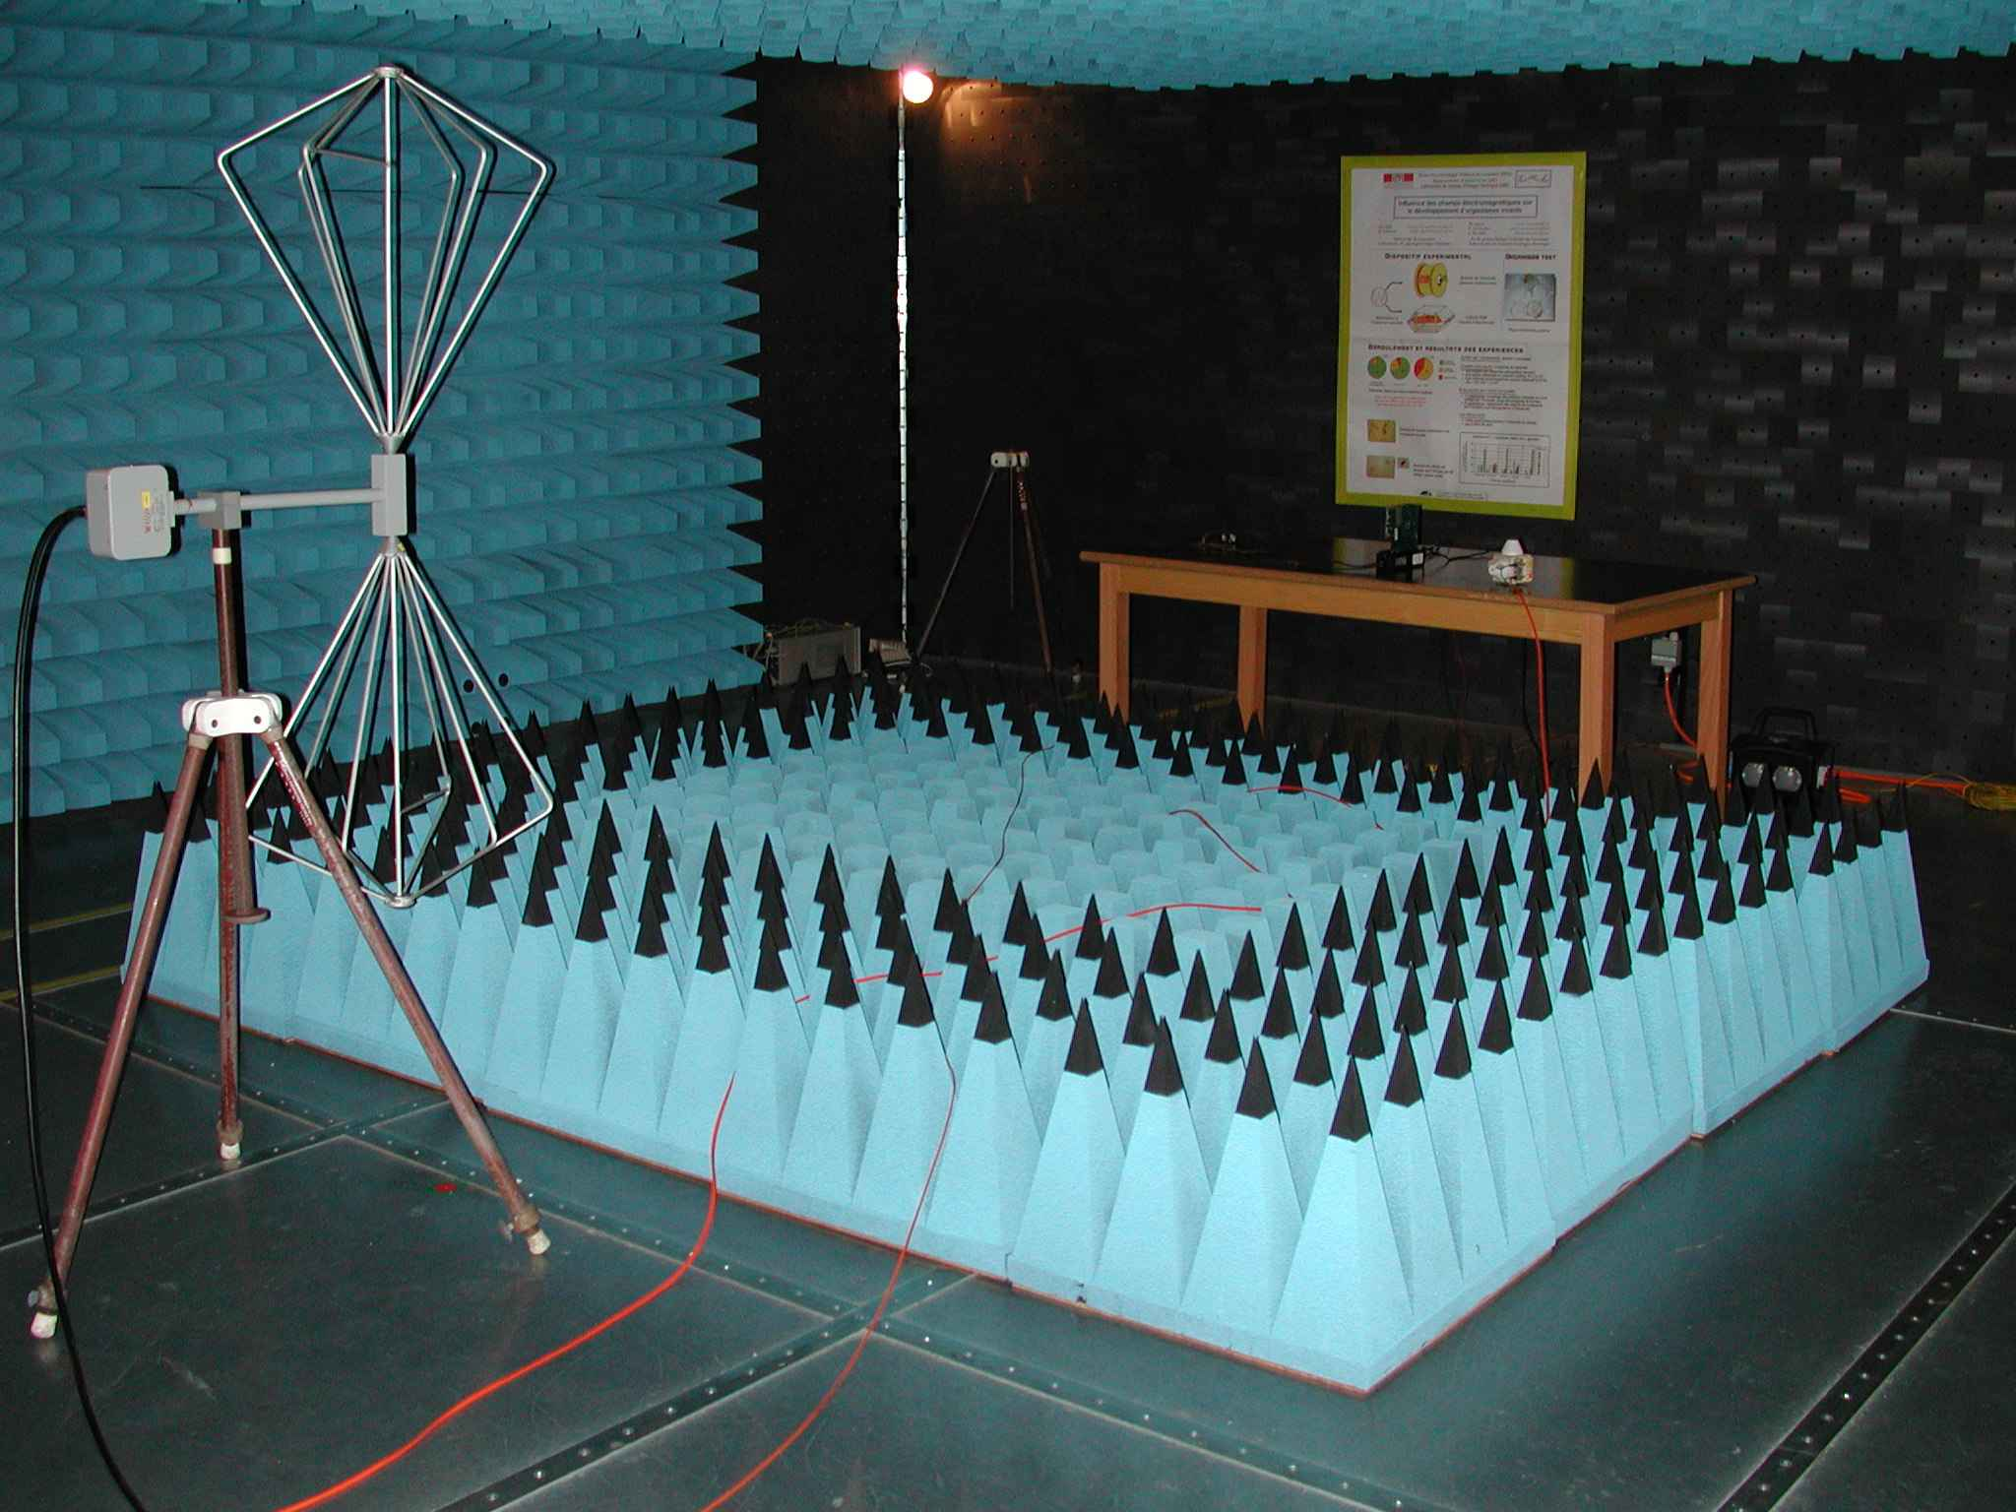
Example: Immunity Test in a Semi-Anechoic Chamber

Slide 51
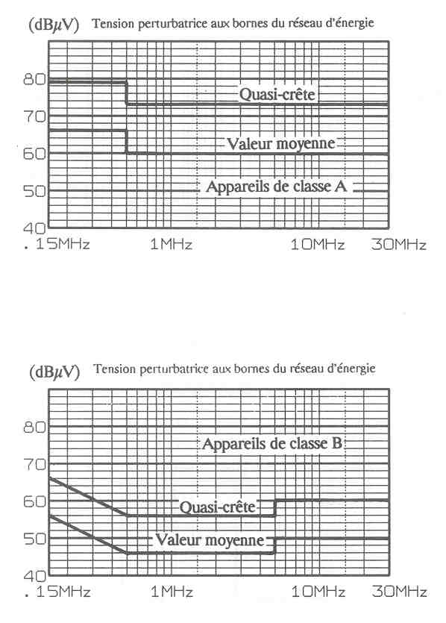
International Standards Example: Conducted Emission Limits
Conducted emission limits EN55022 (CISPR 22) for information technology equipment.
Industrial and Commercial
Devices
Residential Devices

Slide 52
International Standards Example: RadiatedEmission Limits
Radiated emission limits EN55022 (CISPR 22) for information technology equipment.
Class A equipment: 30 m
Class B Equipment: 10 m

Slide 53
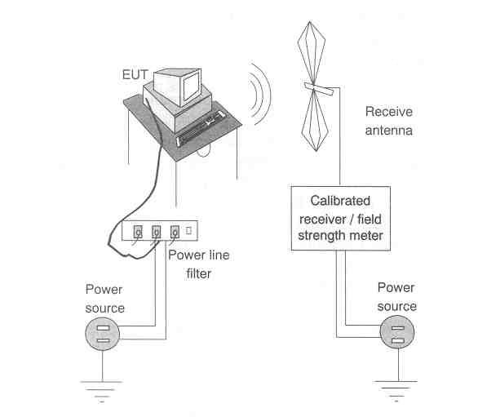
Measurement of Radiated Emissions

Slide 54
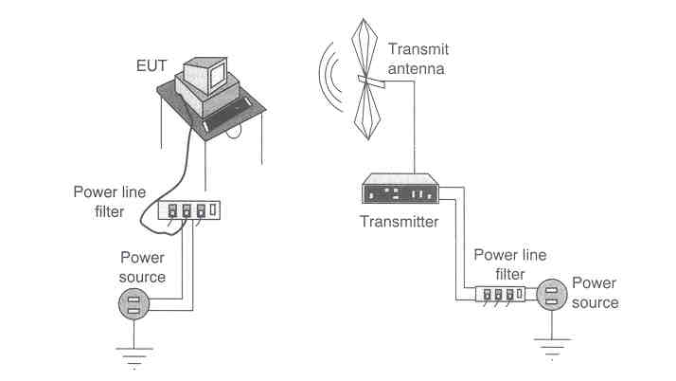
Measurement of Radiated Immunity

Slide 55
EMC Intervention
Research
Phase
Design
Phase
Test
Phase
Production
Phase
Available technical solutions
Costs
Product Development, Time

Slide 56
History of EMC
1930s: Radio interference from electrical apparatus (motors).
1933: Formation of CISPR (Comité International Spécial de Perturbations radioélectriques). Issues addressed by CISPR: definition of acceptable limits for radio interference and measuring methods.
World War II: Extensive interest in using telecommunication and radar facilities by military. Development of military standards for electromagnetic interferences up to 20 MHz.
The most significant increase in the interference problems occurred with the invention of high-density electronic components such a sthe bipolar transistor in 1950s, the integrated circuit in 1960s and the microprocessor chip in the 1970s.

Slide 57
History of EMC (cont’d)
The frequency spectrum also became more crowded with the increased demand for voice and data transmission. This required considerable planning with regard to spectrum utilization.
1979: American regulations by the FCC (Federal Communications Commission) was published limiting the electromagnetic emissions of all digital devices to be below certain limits. Because no digital device could be sold in the United States unless its EM emissions met these limits imposed by FCC, the subject of EMC generated intense interest.
In Europe, starting from 1996, no electrical device could be sold unless its emissions and immunity met the limits imposed by CENELEC.

Slide 58
Decibels and Common EMC Units
Primary quantities of interest in EMC problems are:
Conducted emissions Voltage (V) and current (A)
Radiated emissions E-field (V/m) and H-field (A/m).
Associated with these primary quantities are:
Power (W) or power density (W/m²)
The numerical range of these quantities can be quite large.
For example, E-fields can have values ranging from 1 µV/m to 200 V/m or more. This represents a dynamic range of over 8 orders of magnitude.
Thus, EMC units are often expressed in decibels (dB).
Decibels have the property of compressing data, e.g., a range of 10⁸ is 160 dB.

Slide 59
Decibels and Common EMC Units (cont’d)
Decibels are the logarithmic ratio of two quantities. Initially, dB has been used to express the ratio of two powers P₁ et P₂ :
Absolute power, voltage or current levels are expressed in dB by giving their value value referenced to some base quantity. For example, voltages are commonly expressed relative to 1 µV as dBµV:
Example : U₁ = 120 dBµV ➔ U₁ = 10⁶ µV= 1 V

Slide 60
Decibels and Common EMC Units (cont’d)
In general, a quantity X referenced to y:
Common reference values in EMC:
Quantity
‘Unit’
Reference value
Voltage
dBμV
1 μV
Current
dBμA
1 μA
Power
dBm
1 mW
E-field
dBμV/m
1 μV/m
H-field
dBμA/m
1 μA/m

